Slide 1
Board of Curators Meeting
Melissa Ringhausen, Athletic Director
2021-22 Update
M I N E R A T H L E T I C S . C O M

Slide 2
17
S&T Athletics Overview
Women’s Sport
Basketball
Cross Country
Soccer
Softball
Track & Field
Volleyball
Men’s Sport
Varsity Sports
Baseball
Basketball
Cross Country
Football
Golf
Soccer
Swimming
Track & Field
Volleyball
DII
Conference
434
Student-Athletes

Slide 3
Graduation Rates & Academic Success Rates (ASR)
Based on a 4 -year cohort
 | All Students | Student-Athletes | ASR
2022 | 65% | 74% | 79%
2021 | 65% | 76% | 80%
2020 | 67% | 77% | 81%
2019 | 65% | 75% | 81%
2018 | 66% | 74% | 81%

Slide 4
Academic Portrait
Ye a r ly Gra de Point Ave ra ge (GPA)
 | Women ’s Sports | Men ’s Sports | All Sports
2021-22 | 3.551 | 3.371 | 3.461
2020-21 | 3.492 | 3.274 | 3.383
2019-20 | 3.528 | 3.400 | 3.464
2018-19 | 3.283 | 3.209 | 3.246
2017-18 | 3.369 | 3.115 | 3.242

Slide 5
Academic Awards
Grea t La kes Va lley Con ference (GLVC) | 2021-22 | 2020-21
GLVC Academic All-Conference (GPA 3.3+) | 269 | 232
GLVC Brother Gaffney Distinguished Scholar Award (4.0 Yearly GPA) | 69 | 41
GLVC COP Academic Excellence Award (Exhaust Eligibility with GPA 3.5+) | 32 | 10
GLVC Academic Team Award (Team GPA 3.3+) | 9 | 10
CoSIDA Academic All-American | 5 | 6

Slide 6
Athletic Awards & Honors
GLVC Honors | 2021 -22
GLVC All-Conference Student-Athletes | 50
GLVC Player of the Week Honors | 18
GLVC Individual Championships | 7
GLVC Coach of the Year | 2
GLVC Freshman of the Year | 1
GLVC Male Student-Athlete of the Year | 1
GLVC Team Championship | 1
NCAA Honors | 2021 -22
Individual NCAA Championship Appearances | 16
NCAA All-America Honors | 15

Slide 7
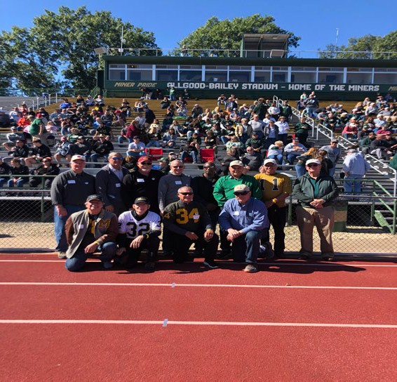
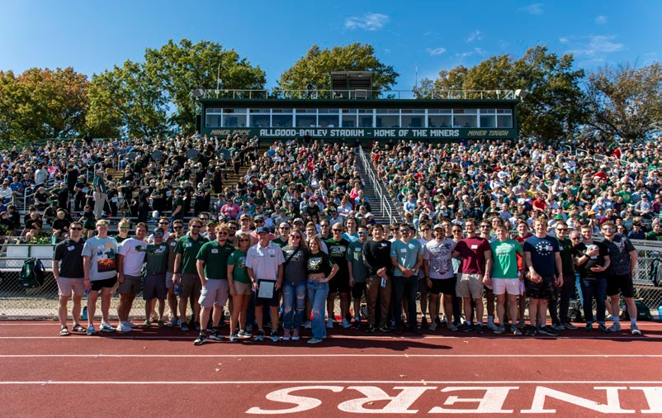
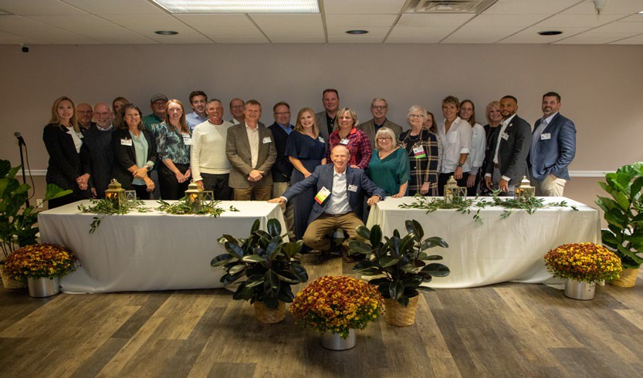
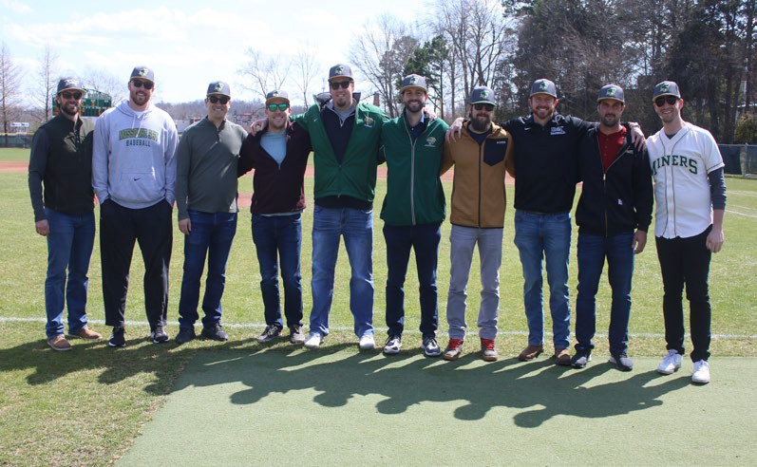
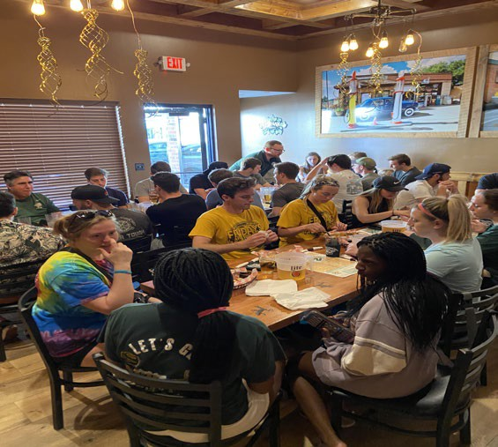
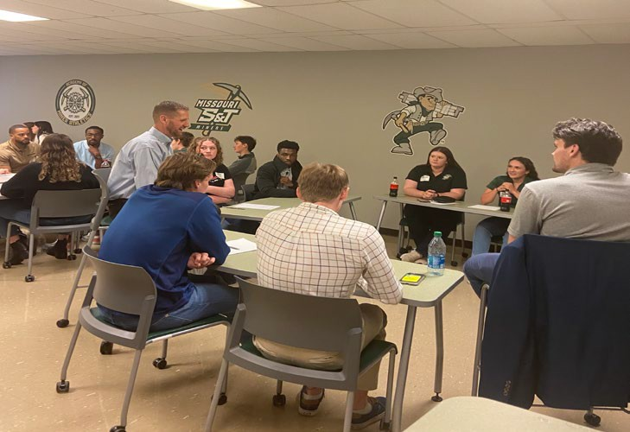
Special Events & Alumni
Swimming Reunion
1970 Football Team
Academy of Miner Athletics
2011 Baseball Team
Soccer Alumni Weekend
Professional Life Skills Development

Slide 8
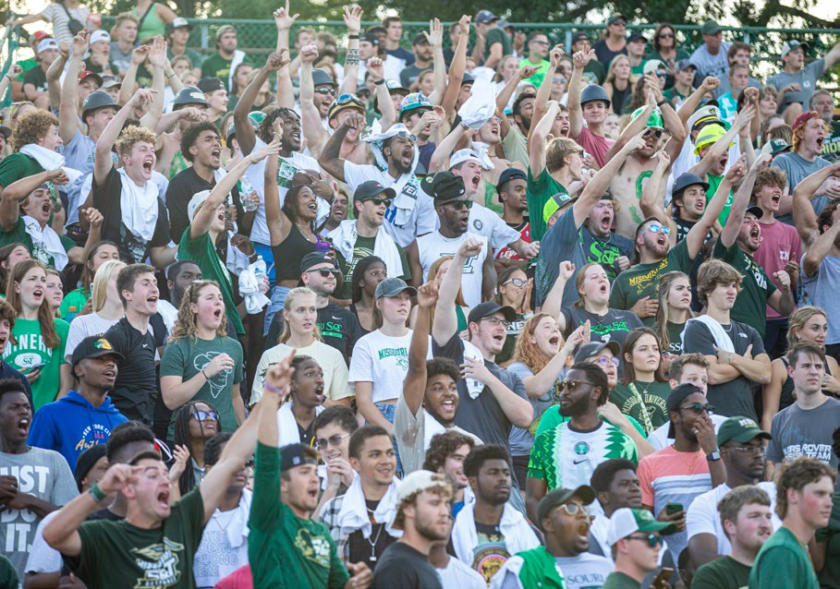
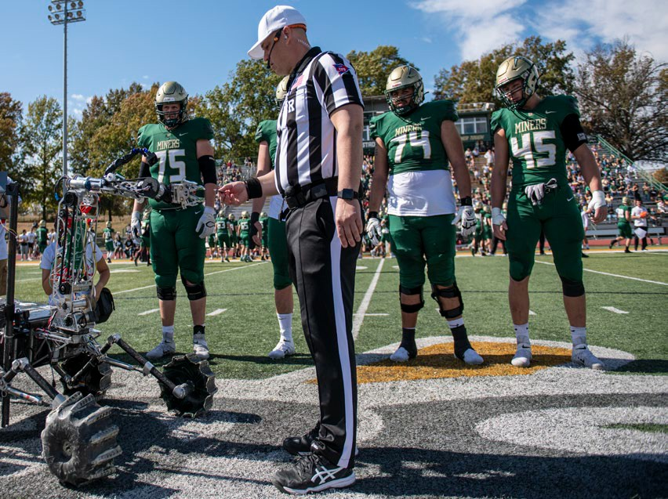
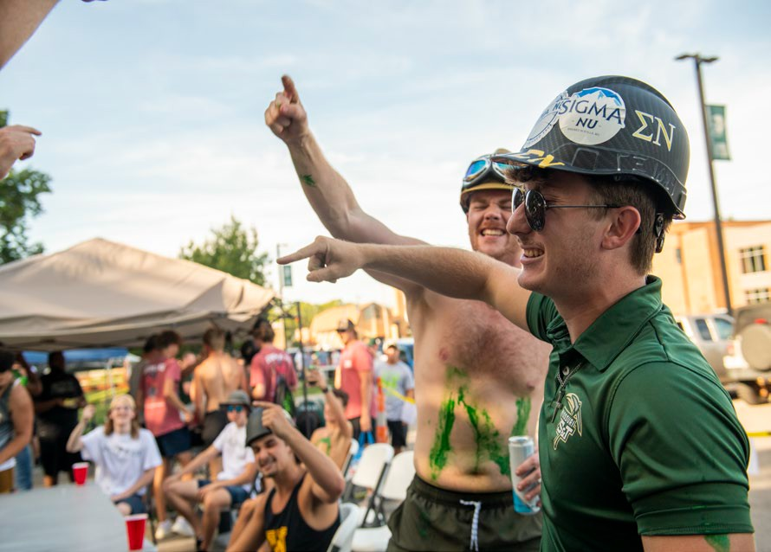
Changing the Culture
Enhance the campus culture, Miner pride, and a sense of belonging for all students.

Slide 9
Questions?
Thank you!

